Slide 1
TEACHING FOR POSITIVE BEHAVIOUR
Supporting engagement, participation, and learning
Notes:
NOTES FOR SESSION PRESENTER
In total this presentation should take approximately 1.5 hours. You will need good wi-fi access to access some of the links and play the videos. If this isn’t possible, go to https://pb4l.tki.org.nz/PB4L-School-Wide/Support-material to download the videos you intend to use and play them from your own computer.
Feel free to adapt this presentation to suit the context or audience you are working with, and, if time is short, to drop one of the activities and/or videos. In particular, note that you will be required to select either slide 9 or 10, depending on which video is best suited to your audience.
A key aim of the presentation is to motivate participants to explore and use Teaching for Positive Behaviour over the coming weeks and months. Ensure that there are enough copies of the book available for participants to have one each, or at least one between two. (Multiple copies were sent to all schools in 2017; additional copies are available from the Ministry via Down the Back of the Chair; phone 0800 660 662 and quote item number 77669.)
Greet participants and introduce yourself. Begin by explaining that today’s session is on this valuable resource for teachers in all New Zealand English-medium schools.

Slide 2
Te piko o te māhuri, tērā te tupu o te rākau.
The way a sapling is nurtured determines how strong it will grow as a tree.

Slide 3
Acknowledgments / Ngā mihi
The writer, Dr Tracy Rohan
The teachers and students who appear in photographs in the resource and in the videos that accompany it
PB4L–SW schools and kura that have informed the resource
Richard Busfield and Angus Macfarlane, who speak in the accompanying videos
Notes:
Additional information to use if you wish:
Tracy Rohan is a principal adviser in the Ministry of Education’s Christchurch office. She is also the author of He Māpuna te Tamaiti, an equivalent (or ‘companion’) document to Teaching for Positive Behaviour for early learning services. This was published in 2019 and has been extremely well received across the country.
Nearly half of New Zealand schools and kura have PB4L-SW (Positive Behaviour for Learning – School-wide) in place. Teaching for Positive Behaviour is underpinned by the philosophy and approaches of PB4L-SW and has been written for the New Zealand context so that any school can use it to support teaching and learning.
The accompanying videos are discussed in slide 5, and two of them are viewed during the presentation.

Slide 4
Purpose of the resource
To support teachers to understand and draw on effective practices that enhance students’
behaviour
engagement
participation
learning.

Slide 5
Components of Teaching for Positive Behaviour
A 68-page book
A self-assessment tool
Four introductory videos
This PowerPoint presentation
Notes:
Explain:
1. The book is the key resource. It’s designed for you to dip in and out of, with key messages revisited in different ways throughout.
2. The self-assessment tool is designed to help you reflect on your practice and is especially helpful when used collaboratively with one or more colleagues who can observe and provide feedback on your practice.
3. The videos and Powerpoint are found on TKI at https://pb4l.tki.org.nz/PB4L-School-Wide/Support-material and are designed to support teachers to familiarise themselves with the resource. We’ll see some of the videos later on.

Slide 6
Key features of the resource
The New Zealand Curriculum is its foundation.
It presents universal strategies that can be used with all students in years 1–13.
It promotes culturally responsive practices and inclusive pedagogies.
It supports positive student–student and student–teacher relationships.
It encourages teacher reflection on effective practices for supporting positive behaviour.
It promotes inquiry, problem-solving, and sharing of effective practices.
Notes:
Explain:
This resource is aligned with the New Zealand Curriculum and its key competencies and recommended pedagogical approaches.
This is a ‘tier one’ resource that explores preventative strategies that support all students and that are equally valuable across primary and secondary contexts.
Culturally responsive practices and inclusive pedagogies benefit all students and are central to this resource.
The strategies in this resource will help to foster positive relationships between you and your students and among your students.
The resource supports teachers to examine and improve the ways in which they support positive behaviour.
It also offers strategies for inquiring into practice and collaborating with colleagues to solve problems and share what is learnt.

Slide 7
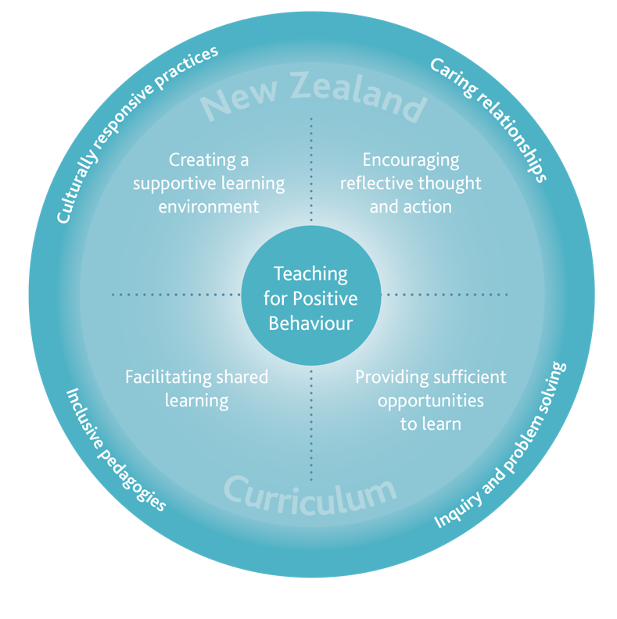
Framework for the resource
Notes:
Work through and unpack the diagram (from page 7):
As already discussed, the New Zealand Curriculum is the foundation for this resource.
The strategies promoted by the resource are grouped under four evidence-based teaching approaches from the curriculum (page 34) that have been shown consistently to have a “positive impact on student learning”: Creating a supportive learning environment; Encouraging reflective thought and action; Facilitating shared learning; and Providing sufficient opportunities to learn.
The four elements around the outside of the diagram – Culturally responsive practices, Caring relationships, Inclusive pedagogies, and Inquiry and problem solving – underpin the four teaching approaches. They support you to increase engagement and maximise students’ learning and are unpacked in the introduction to the book.

Slide 8
Structure of the resource
Introduction
Section 1: Creating a supportive learning environment
Section 2: Encouraging reflective thought and action
Section 3: Facilitating shared learning
Section 4: Providing sufficient opportunities to learn
Section 5: Reflection, inquiry, and problem solving
Notes:
Explain that the structure of the book mirrors the framework on the previous slide.
It has an introduction and four main sections corresponding to the four effective pedagogies of the book’s framework (and from the NZC), plus a fifth section to assist teachers to reflect on their practice and to collaborate to share information and solve problems.

Slide 9
Using Teaching for Positive Behaviour in years 1–8
DESIGNER -- Embed video 2, linking to video clip online
https://pb4l.tki.org.nz/PB4L-School-Wide/Support-material
Notes:
IMPORTANT – CHOOSE FROM EITHER THIS OR THE NEXT SLIDE, DEPENDING ON WHICH VIDEO WILL BEST SUIT YOUR AUDIENCE. (THE TWO VIDEOS ARE VERY SIMILAR, SO IT WON’T WORK TO WATCH BOTH, REGARDLESS OF YOUR AUDIENCE.)
Explain that we’ll now look at one of the four videos. The presenters are the author, Tracy Rohan, and Richard Busfield, who has used Teaching for Positive Behaviour extensively with schools in Canterbury.
After watching the video, allow participants a few minutes to discuss their responses to it – what they learnt from it, what was new or familiar to them, and any points that particularly struck them. (If you are working with a small group, do this as a whole. If a large group (more than about 6), split into smaller groups.)

Slide 10
Using Teaching for Positive Behaviour in years 9–13
DESIGNER – Embed video 3, linking to video clip online
https://pb4l.tki.org.nz/PB4L-School-Wide/Support-material
Notes:
IMPORTANT – CHOOSE FROM EITHER THIS OR THE PRECEDING SLIDE, DEPENDING ON WHICH VIDEO WILL BEST SUIT YOUR AUDIENCE. (THE TWO VIDEOS ARE VERY SIMILAR, SO IT WON’T WORK TO WATCH BOTH, REGARDLESS OF YOUR AUDIENCE.)
Explain that we’ll now look at one of the four videos. The presenters are the author, Tracy Rohan, and Richard Busfield, who has used Teaching for Positive Behaviour extensively with schools in Canterbury.
After watching the video, allow participants a few minutes to discuss their responses to it – what they learnt from it, what was new or familiar to them, and any points that particularly struck them. (If you are working with a small group, do this as a whole. If a large group (more than about 6), split into smaller groups.)

Slide 11
Each major section includes …
Key strategies unpacked and illustrated over 1–4 pages
Stories from practice
Professional learning activities
Links to additional information (websites, videos, articles etc)
Notes:
Explain that you’ll come back to the self-assessment tool discussed in the video later on.
Now explain how each of the book’s four major sections includes these four different components, and that we’ll now go on to look at examples of each of them …

Slide 12
Each major section includes …
Key strategies unpacked and illustrated over 1–4 pages
Stories from practice
Professional learning activities
Links to additional information (websites, videos, articles etc)
Notes:
… beginning with an example of how one of the four major sections unpacks key strategies.

Slide 13
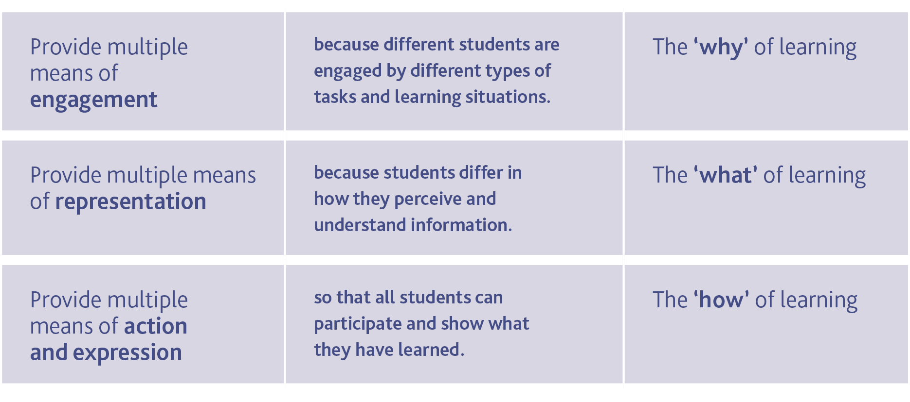
Section 4: Providing sufficient opportunities to learn
A UDL approach
Notes:
Explain that you’ve chosen section 4 as an example:
Like the other major sections, it begins with a general discussion of the key pedagogical approach the section is focusing on. For this section, this includes the key role and principles of Universal Design for Learning.
It then unpacks strategies that reflect these principles and provide students with sufficient opportunities to learn.
These strategies will help you to think about the diverse needs of students in your learning space and to remove barriers to their learning.

Slide 14
Providing sufficient opportunities to learn
Presenting information in a variety of ways to support understanding
Providing alternatives for students to demonstrate their learning
Supporting student responses
Providing choice
Structuring tasks strategically
Notes:
Highlight the five key strategies of section 4. Then divide participants into five groups and assign each group one of the strategies (pages 43–53) to read and discuss. After 10 minutes, ask a representative from each group to provide a brief summary of the strategy they discussed.
The following notes on the five strategies may help you in prompting participants’ summaries.
Presenting information in a variety of ways – for example, visual/pictorial, oral, or written – so that students can refer to and use whatever clues they need to gain an understanding.
Providing alternative ways for students to demonstrate their learning – by employing a mixture of visual, oral, written, and arts-based performance tasks through which students can show their understanding; and by using digital tools through which students can share ideas or create portfolios of their work.
Supporting student responses – through cooperative ways of sharing ideas (e.g., ‘turn and talk’); and by varying the way students can respond by, for example, giving them response cards, thumbs up/down, digital voting, or ‘whole body’ responses (e.g., stand up/sit down).
Providing choice –– to increase engagement by allowing students to feel in control of their learning. You can do this by: giving students opportunities to make choices within and across tasks – for example who they work with, where they work, which tasks they will work on, the order they can complete the tasks, and what to do after completion; and by designing a variety of rich tasks and setting a minimum number that students should complete, while allowing them to decide which to work on.
Structuring tasks strategically – by mixing easier tasks with more difficult ones; by beginning with easier tasks with teacher support and moving to more difficult tasks, gradually releasing responsibility; and by breaking tasks into manageable chunks.

Slide 15
Each major section includes …
Key strategies unpacked and illustrated over 1–4 pages
Stories from practice
Professional learning activities
Links to additional information (websites, videos, articles etc)
Notes:
Explain that you’ll now look at two examples of stories from practice. The first is an example from a primary school, the second from a secondary school. Both will be valuable to look at, but if you are pushed for time, choose the one that is most appropriate for your audience.

Slide 16
Example of a story from practice: Taylor & Millie
Read the story on page 21 and discuss with your neighbour:
What are the key messages in this story?
What are the examples of inclusive practice that the story highlights?
How have barriers to learning, participation, and engagement been removed for Millie?
Notes:
For the first example of a story from practice, ask participants to work in pairs for 5–7 minutes on the above activity.

Slide 17
Example of a story from practice: Max
Max, a year 11 student in a Dunedin college, has successfully avoided written work for many years. While he has ideas and experiences to share and an interest in automotive engineering that suggests a likely career path, disengagement in the classroom has put him on the wrong side of many of his teachers and resulted in a low rate of task completion.
Typically Max has a hard time getting started on writing tasks, has difficulty planning and sequencing ideas, and struggles with spelling and the mechanics of writing. He shows his frustration and lack of motivation through non-compliance and a tendency to distract others with off-task behaviour.
This year the school has been implementing a Universal Design approach to remove barriers to success for students such as Max. A learning coach has helped Max to embark on a personalised pathway, ensuring that schoolwork feels more relevant and aligned with his plans for the future.
Max’s teachers have successfully implemented a number of strategies to support his learning, particularly in the area of writing.
Notes:
For the second example of a story from practice, lead participants through the following activity:
Read aloud the first four paragraphs of Max’s story on page 47 of Teaching for Positive Behaviour, as on this slide. Give participants an extra minute or so to reread it to make sure they fully understand Max’s situation. Then move onto the next slide.

Slide 18
Example of a story from practice: Max
Working in a small group, discuss how would you use the strategies below to support Max to be more engaged in the classroom, particularly in writing:
Presenting information in a variety of ways to support understanding
Providing alternatives for students to demonstrate their learning
Supporting student responses
Providing choice
Structuring tasks strategically
Notes:
Now have participants work in small groups to identify how they might use section 4’s strategies to support Max to be more engaged in the classroom.
After approximately 5 minutes, bring the group together again and read the remainder of the story. (It’s on the next slide, or participants at this point could open the book at page 47 and read along with you.)

Slide 19
Example of a story from practice: Max (continued)
Max’s teachers have successfully implemented a number of strategies to support his learning, particularly in the area of writing. These include:
offering alternative ways for Max to show and share his learning and knowledge – for example, digital tools such as speech recognition software mean that the physical act of writing is no longer the chore it once was
ensuring that writing tasks are high interest with authentic topics for authentic audiences – Max has had particular success writing a blog reviewing new cars in the style of ‘Top Gear’
dividing work into smaller, more manageable tasks, with a reduced assignment load and focusing on quality rather than quantity
using graphic organisers and mind mapping to help with the organisation and sequencing of ideas.
According to the year 11 dean, Max has now found a new ‘gear’ and is well placed for a successful year as he tackles NCEA level 1.
(page 47)
Notes:
After reading through the remainder of the story from the book or this slide, allow the original small groups 2–3 minutes to discuss how the strategies they identified align with those in the learning story.

Slide 20
Each major section includes …
Key strategies unpacked and illustrated over 1–4 pages
Stories from practice
Professional learning activities
Links to additional information (websites, videos, articles etc)
Notes:
Explain that you’ll now look at an example of a professional learning activity from Section 2, ‘Encouraging reflective thought and action’.
For this activity, participants will each need a copy of the book, or sharing a copy between two will work. If you don’t have enough copies for this, you’ll need to photocopy pages 28–29 in advance of the session.

Slide 21
Example of a professional learning activity
Section 2 focuses on ‘Encouraging reflective thought and action’.
The activity below is based on its first key strategy, ‘Encouraging self-regulated behaviours’.
Read pages 28–29. Then work with 3-4 colleagues to:
discuss paragraphs 1-2: what ideas stood out for you?
discuss paragraphs 4-5: what implications do they have for your everyday classroom practice?
complete the activity at the bottom of page 29.
Notes:
Give participants 15–20 minutes for this activity – 2–3 minutes to read the two pages, and then 5–6 minutes per bullet on the slide. Prompt them to move onto the next bullet after about 7 and 12 minutes.

Slide 22
Each major section includes …
Key strategies unpacked and illustrated over 1–4 pages
Stories from practice
Professional learning activities
Links to additional information (websites, videos, articles etc)
Notes:
Explain that you’ll now briefly look at an example of links to additional information.

Slide 23
Example of links to additional information
The webpage Teacher Talk Moves and the video Improving Participation with Talk Moves discuss a helpful strategy for encouraging learning conversations between students.
The document Turn and Talk: Procedures and Routines unpacks the benefits and routines associated with the turn and talk strategy.
The strategy ‘think, pair, share’ is explored on the website Instructional Strategies Online.
From page 48, for the strategy ‘Supporting student responses’
Go to https://pb4l.tki.org.nz/PB4L-School-Wide/Support-material to download the PDF of the book and activate the links.
Notes:
Briefly take participants through this example of links to additional information. Explain that there are links like this for most of the key strategies in the book, and that to activate them, they’ll need to download and use the PDF of the book. Click on the link on this screen to show where you go to download the PDF.

Slide 24
Reflection, inquiry, and problem solving
Supports teacher professional learning and problem solving to improve outcomes for students
Encourages individual as well as whole-school inquiry
Helps to understand behaviour and what might be driving it
Includes questions to support collaborative problem solving
Includes questions to support planning an appropriate response
Notes:
Explain that the fifth section of the book supports teachers to reflect on their thinking, attitudes, values, and practices.
Reflection and inquiry support both teacher professional learning and the solution-focused, problem solving that improves outcomes for students.
The section encourages teachers to consider the kinds of evidence that could inform their inquiry into their own practice and into whole-school practices that support student well-being and positive behaviour.
The section provides strategies to help teachers understand and support students with challenging behaviour.
(& 5) It includes questions to help teachers collaborate to problem solve challenging behaviour and to plan responses that will lead to positive behavioural change.

Slide 25
Supporting individual students or small groups of students
DESIGNER -- Embed video 4, linking to video clip online
https://pb4l.tki.org.nz/PB4L-School-Wide/Support-material
https://pb4l.tki.org.nz/PB4L-School-Wide/Support-material
Notes:
Explain that we’ll now watch another of the videos that support the book. After watching it, reinforce how valuable many schools and teachers have found the questions on pages 59 and 60.

Slide 26
Self-assessment tool
Supports teachers to examine their practice
Based on the strategies that Teaching for Positive Behaviour promotes
Will help you review your learning environment and approaches that support engagement, participation, and learning
Can help you to identify aspects of practice to work on – especially when done with a colleague or a peer observer
Available as an interactive PDF or Word document at https://pb4l.tki.org.nz/PB4L-School-Wide/Support-material
Notes:
Explain that section 5 contains a self-assessment tool that:
supports teachers to examine their practice and reflect on the degree to which it includes effective, evidence-based strategies that promote positive behaviour
is based on the strategies the book promotes
helps teachers to review their learning environment and the approaches they use that support inclusion, engagement, participation, and learning
teachers can use to reflect on their individual practice, possibly in collaboration with a colleague. For example, a colleague can support them to use the tool by observing them and providing specific feedback to help plan ways to strengthen their practice.
Go online to https://pb4l.tki.org.nz/PB4L-School-Wide/Support-material to show how to access the tool and open it up to demonstrate how teachers can work in either the PDF or Word document and save a copy. This supports them to compare results over several uses of the tool.

Slide 27
Kia kaha tō koutou mahi!
Notes:
Wrap up the session:
if appropriate, explain that participants who teach in years 1–3 might want to check out He Māpuna te Tamaiti, which is a companion resource also written by Tracy Rohan, for early learning services
wish them well as they explore Teaching for Positive Behaviour and use it in their day-to-day practice.

